Slide 1
FUSION: Hybridoma formation

Slide 2
Prior to Cell fusion
Prior to Cell fusion, it is essential that:
The myeloma cells are in the log phase of growth ensured by frequent dilution
Cell density: not greater than 10⁶/ml
Cell viability: >95%

Slide 3
Fusion between B cells and Myeloma
the B-cells and myelomas can be made to fuse by chemical protocols, most often using polyethylene glycol.
Cells are incubated in HAT medium (hypoxanthine-aminopterin-thymidine medium) for roughly 10 to 14 days.

Slide 4
Polyethylene glycol
Polyethylene glycol (PEG) induces rapid fusion of cells. Membrane fusion, as detected by formation of pentalaminar membrane arrays, occurs as early as 1 min after PEG treatment.
PEG is the most widely used of the water-soluble fusogens. The usefulness of PEG stems from its:
low cytotoxicity for most cells,
high fusion rate,
ease of handling and
reproducibility
Two somatic cells can be caused to fuse in vitro to produce a heterokaryocyte , which is a single hybrid cell containing 2 or more nuclei. The first mitotic division after fusion will lead to a population of daughter ells that carry both sets of parent cell chromosomes in the same nucleus. Often, at subsequent divisions chromosomes are lost in ones and twos until a new cell line is formed carrying some chromosomes from each parent.

Slide 5
The ideal conditions of Polyethylelene glycol in cell fusion
MWt: 1500-4000
The con Of PEG: 40-50%
PH: 8-8.8.2
Time of exposure to PEG: 1-2 min
Temp: 20-37ºC
Ratio of cells: 1:1-10:1 Lym to Myeloma cells

Slide 6
HAT medium
HAT Medium (hypoxanthine-aminopterin-thymidine medium) is a selection medium for mammalian cell culture, which relies on the combination of:
Hypoxanthine (a purine derivative)
Aminopterin, a drug that acts as a powerful folate metabolism inhibitor by inhibiting dihydrofolate reductase
Thymidine (a deoxynucleoside) which are intermediates in DNA synthesis
The trick is that aminopterin blocks DNA de novo synthesis, which is absolutely required for cell division to proceed, but hypoxanthine and thymidine provide cells with the raw material to evade the blockage (the "salvage pathway").

Slide 7
Fusion
Myeloma cells and B cells are incubated in HAT medium for roughly 10 to 14 days.
Unfused myeloma cells die, as they cannot produce nucleotides by the de novo or salvage pathways because they lack HGPRT. Removal of the unfused myeloma cells is necessary because they have the potential to outgrow other cells, especially weakly established hybridomas.
Unfused B cells die as they have a short life span.
the B cell-myeloma hybridomas Only survive, since the HGPRT gene coming from the B cells is functional.
These Hybridoma cells produce antibodies (a property of B cells) and are immortal (a property of myeloma cells)..

Slide 8
Possible Fusion Products
Myeloma HGPRT Deficient And Ig Deficient
+
Plasma Cells From Immunized Animal
❒
Senescence
✓
Can Use Salvage Pathway
No Senescence
❒
Senescence
❒
HAT Medium
❒
HAT Medium

Slide 9
Fusion protocol
1. Add myeloma cells and B cells together
2. Centrifuge mixed cells 900-1000 rpm 5 min.
3. Slowly add 1 ml PEG to the pelleted cells.
(Do at room temperature).
Dispense PEG along sides of tube. After that, mix by
swirling tube.
4. Incubate for 1 minute at 37ºC7. Distribute cell mixtures in 96-well plate
5. Top up medium in each well
6. Leave plate in 5% CO2, 37ºC incubator overnight before adding HAT medium
Thee FCS must be pretested for its ability to support clonal growth
After addition of PEG all handling of the cells should be as gentle as possible to minimize dispersal of forming hybrids.

Slide 10
Hybridoma selection
On the day following fusion, half the old medium is removed and replaced with HAT
This medium change is repeated on day 2, 4,6,8, 11 and every 3 days afterwards
Within 3-4 days all myeloma cells should be dead. From the fifth day, hybrid s should start to become visible
Screen for specific Ab production (11-14 day)
Select positive AB-secreting wells
Testing of HAT medium
Grow Myeloma cells or Hybridoma cells in HAT medium: Myeloma should die while hybridoma survive

Slide 11
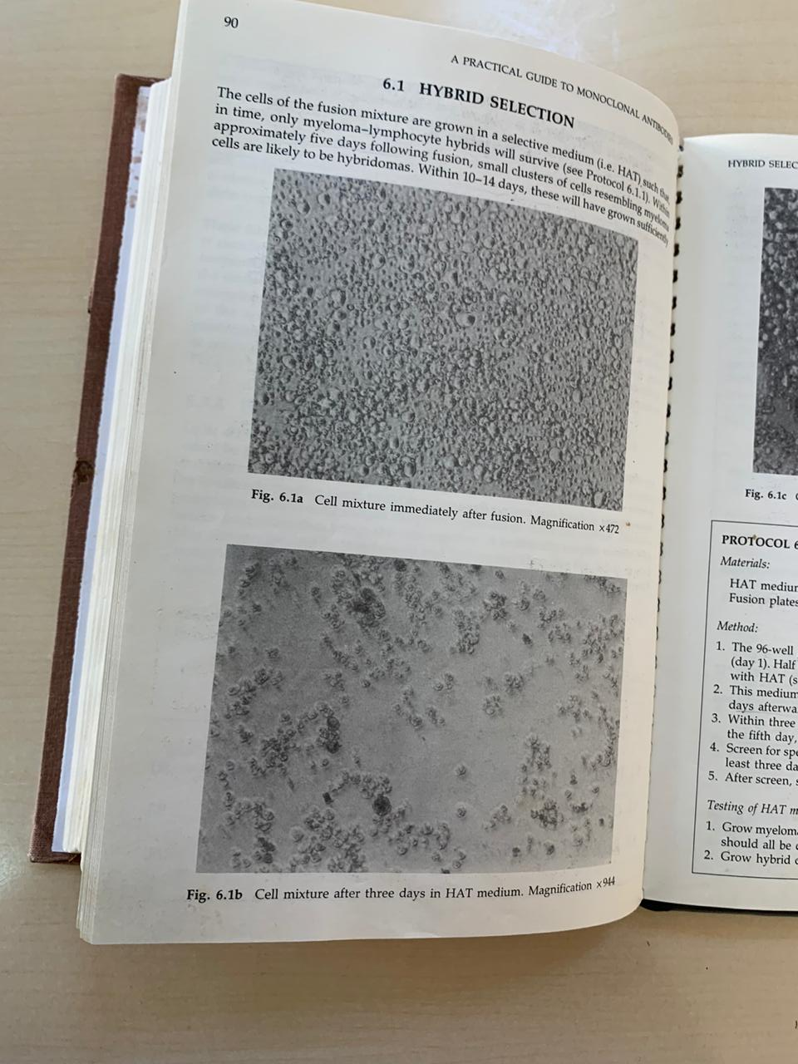

Slide 12
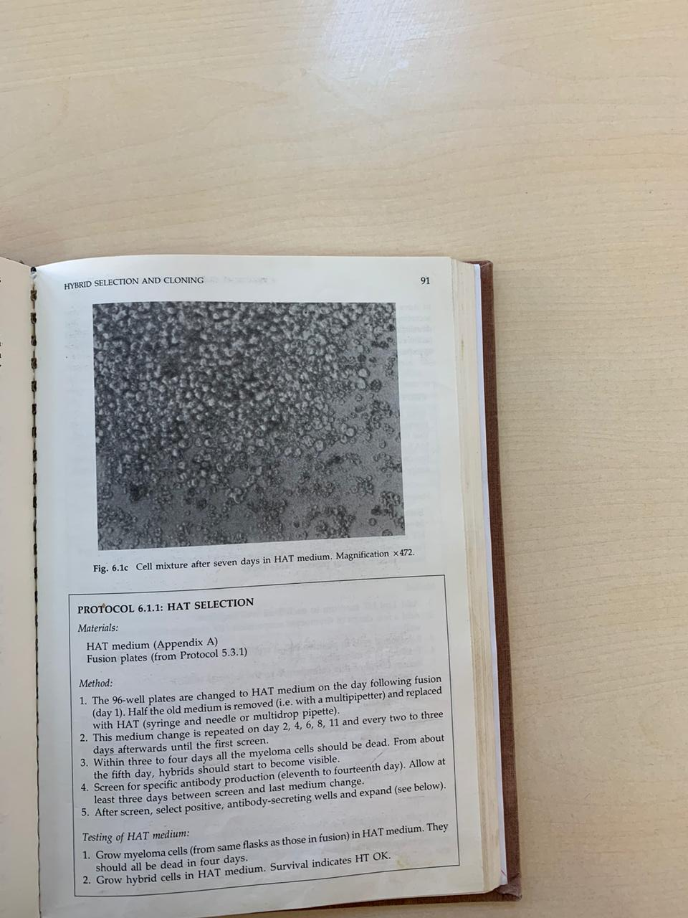

Slide 13
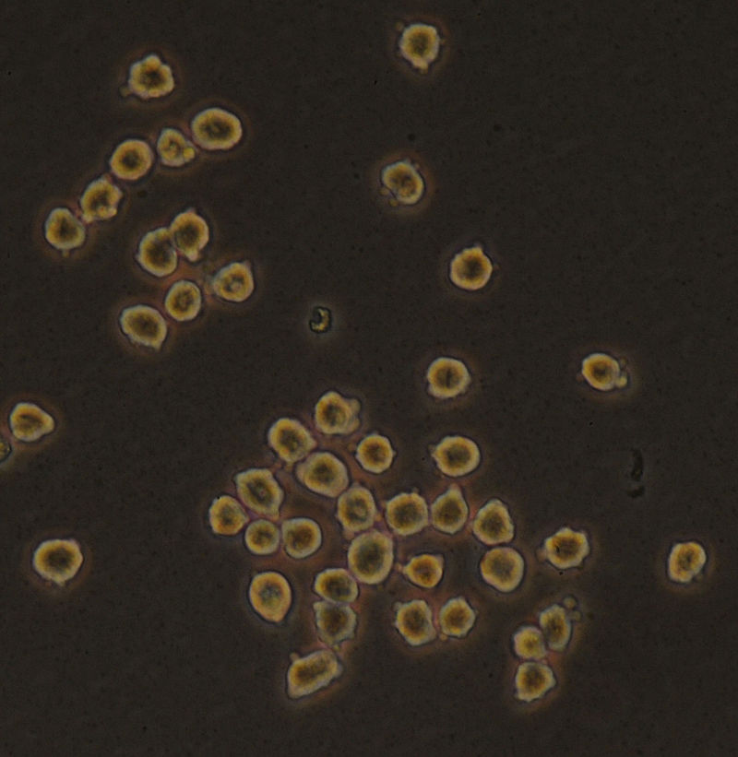
Hybridoma cells grown in tissue culture

Slide 14
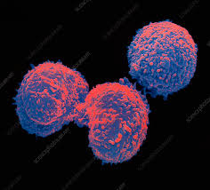
SEM of hybridoma cells

Slide 15
Expansion of culture prior to cloning
a. Manageable number of selected cultures should be expanded into larger wells 8-well plate
b. HAT media is replaced by HT media for several passages before addition of complete medium
c. Feeder cell suspension
Fusion protocol
https://www.youtube.com/watch?v=8iyrbv1JauY

Slide 16
Feeder cells
Feeder cells are necessary to encourage the growth of the hybridoma cells during expansion from microwells, cloning and thawing from frozen storage.
Three commonly used types of feeder cells are: thymocytes, splenocytes and peritoneal macrophages
The source of the growth factors
Thymocytes:
Thymus should be obtained from young animal
It is not necessary to use the same species (Balb/c) as the hybridoma parents
1-2x10⁸ thymocytes/mouse should be obtained
https://www.ncbi.nlm.nih.gov/pmc/articles/PMC4374365/

Slide 17
Preparation of thymic cells
Harvest of Thymus Tissue
Euthanize mouse in a CO2 chamber. Put the animal on its back on a dissection mat, pin the feet on the mat and wet the fur by spraying with 70% ethanol.
Make a midline incision through the skin, starting from above the urethral opening straight up to the lower jaw with scissors and extend the incision downward to the knees on both sides. The incision looks like an upside down “Y”. Pull the loose skin back on the sides, and pin it to the dissection mat.
Puncture the diaphragm from the xiphoid, cut the ribs on each side up to about the clavicle, then lift up the ribs with forceps and pin it to the dissection mat. The thymus is just under the ribs, and looks like two thin white lobes overlying the heart (Figure 1). Disconnect connective tissue surrounding the thymus, gently pull and remove the pair of thymus lobes with curved serrated forceps. Place thymus lobes into a 6 well plate containing 5 ml RPMI-1640.

Slide 18
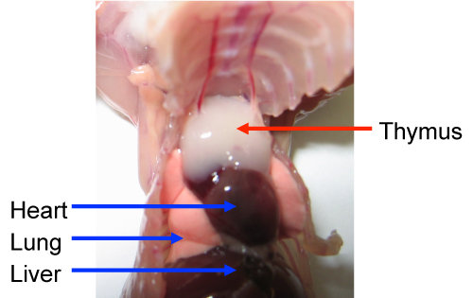

Slide 19
Preparation of Thymic Stromal Cells
Trim any surrounding fat and connective tissue and transfer the thymus lobes to a new well of the 6 well plate containing 5 ml freshly prepare enzyme solution. Make small incisions in the thymus lobes with fine scissors, and incubate the plate at 37 °C for 20 min.
Gently pipette digesting thymus tissue up and down 2 - 3 times using 5 ml pipette for tissue dissociation. Collect supernatant fraction in a 50 ml tube containing 10 ml cold albumin-rich buffer to neutralize enzymes. Keep the collection tube on ice. Add 2.5 ml enzyme solution to the remaining tissue and incubate the plate at 37 °C for 15 min.
Perform gentle mechanical agitation with a 3 ml syringe and 18 G needle to break up aggregates. Pool supernatant into the collection tube. Add 2.5 ml enzyme solution to the remaining tissue and incubate the plate at 37 °C for 15 min.
Repeat gentle mechanical agitation with a 3 ml syringe and a 25 G needle, and incubate the plate additional 5 - 10 min.
After complete digestion, pool the supernatant into the collection tube. Centrifuge the collection tube at 400 x g, 4 °C for 8 min to collect the cells. Aspirate the liquid and suspend the pelleted cells in 10 ml albumin-rich buffer and filter the sample through 100 mm mesh. Count cells using a hemocytometer.

Slide 20
Peritoneal Mac
Swab with alcohol
Make small incision in lower abdomen
Insert perforated tube
Add medium
Gently massage abdomen for 2 min
Remove fluid using Pasteur pipett
Spin
https://www.jove.com/v/1488/isolation-of-mouse-peritoneal-cavity-cells

